Slide 1



ISTANBUL TECHNICAL UNIVERSITY
ANALYSIS OF THE CINEMA INDUSTRY
VISUALIZING SUCCESS FACTORS IN TMDB 5000 DATASET
Emir Arda Eker
Alper Düzgün
Yusuf Karamustafa

Slide 2
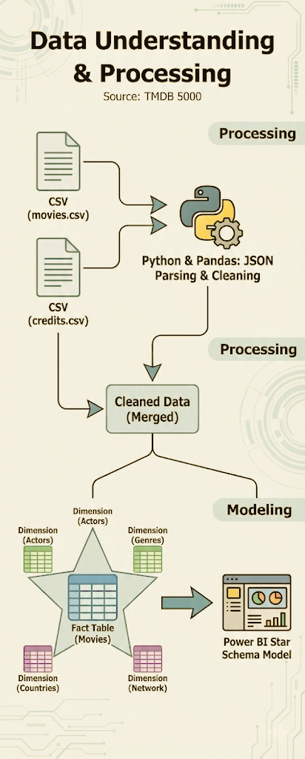
Data Understanding & Processing
From Raw Data to Insights
Source: TMDB 5000 Movies & Credits Dataset.
Cleaning: Merged datasets, parsed JSON columns (Cast, Crew, Genres).
Feature Engineering: Created 'Actor Network' and 'ROI' metrics.
Validation: Flagged outliers and valid financial data.

Slide 3
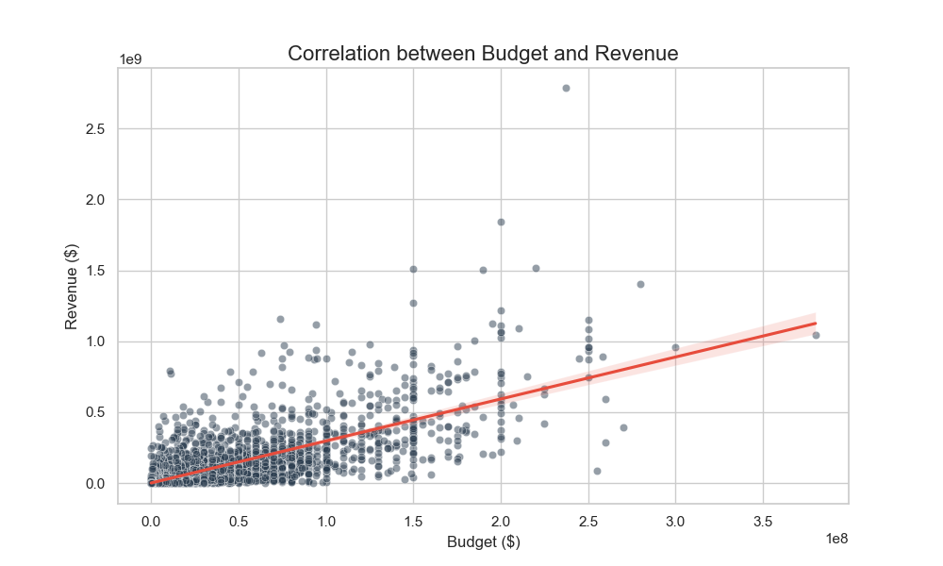
Exploratory Data Analysis (EDA) - Financials
Financial Correlations & The "Horror" Anomaly
Correlation: Strong link between Budget & Revenue (0.73).
The Surprise: No correlation between Budget & Quality (0.09).
Insight: High budget guarantees revenue, not quality.
Outlier: Horror movies (e.g., Paranormal Activity) have the highest ROI (>10,000%).

Slide 4
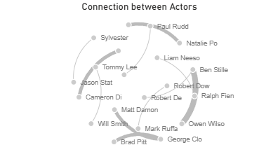
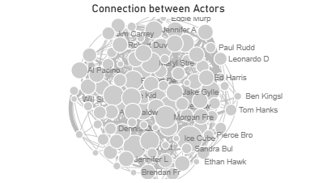
Advanced EDA - The Talent Network
Deciding "Star Power" via Network Analysis
Method: Graph Theory (Nodes = Actors, Edges = Co-starring).
Finding: Significant clustering in the industry (e.g., Marvel Universe, Wes Anderson films).
Optimization: Filtered weak connections (Weight > 1) to reveal true partnerships.

Slide 5
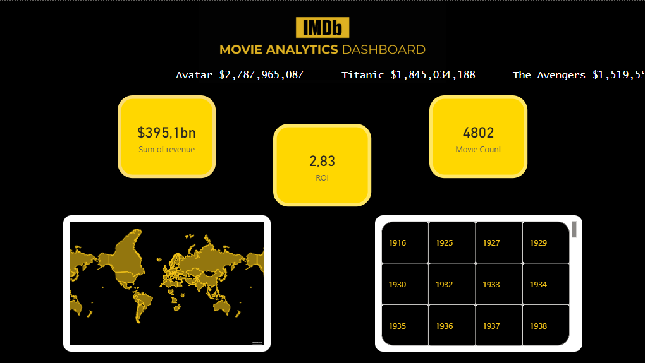
Dashboard Showcase - Executive Summary
The Dashboard: Global Overview
Geospatial Analysis: Production volume by country.
Time Series: Revenue trends from 1920 to 2016.
Interactivity: Tooltips showing local movie counts.

Slide 6
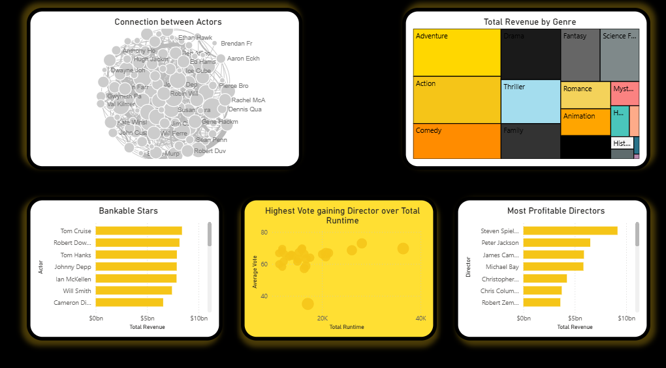
Dashboard Showcase - The Ecosystem
Deep Dive: Talent & Genres
Network Navigator: Interactive exploration of actor connections.
Director League: Analyzing the most profitable directors.
Genre Profitability: Identifying niche opportunities.

Slide 7


Key Takeaways
Conclusion: The Formula for Success
Budget ≠ Quality: You can't buy high ratings.
Network Matters: Casting connected stars reduces risk.
Genre Efficiency: Horror and Sci-Fi offer the best financial leverage.

Slide 8
Thank You

